Slide 1
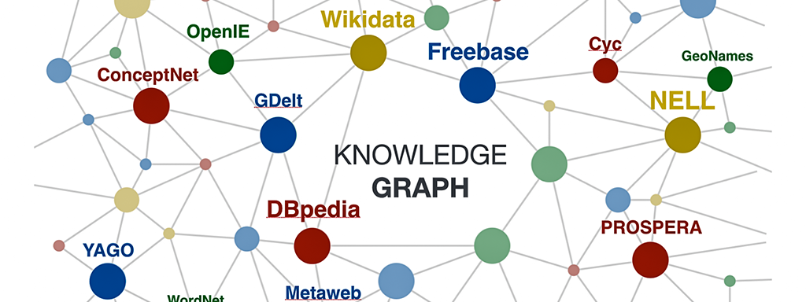
Open Data and Knowledge Graphs
Hands-on Group 01
November 2020
Máster Universitario en Ingeniería Informática
Universidad Politécnica de Madrid
Eduard Aymerich @eduayme
Jose Dominguez @jose-dp
Sol Domínguez @solDC
Rafael Timermans @Rafata8

Slide 2
Contents
Open Data Generation Process
Application

Slide 3



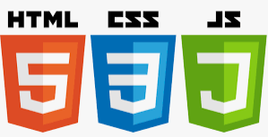

I. Open Data Generation Process
Select, Obtain Access and Analyse Data Source
Create Ontolgy
Clean, Preparare
Transform Data Source
Link and Reuse
Develop Application
Tasks
Select dataset
Analyse License
Undestand data
Define naming strategy
Create ontology
Clean and prepare data
Data mapping
Link data with other data sources
Reuse existing ontologies
Publish rdf data
Develop application using rdf data
Tools

Slide 4

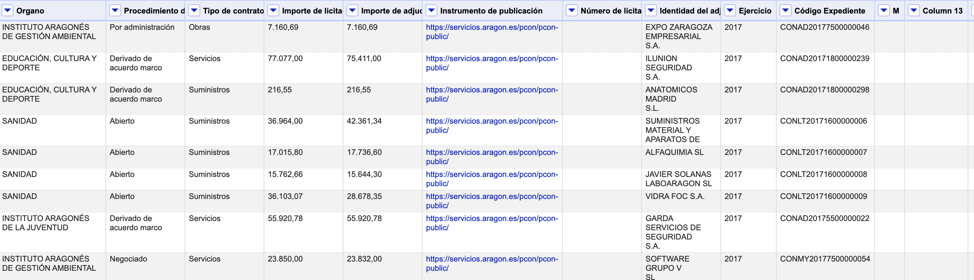
Select, Obtain Access and Analyse Data Source
Contracts awarded by the Government of Aragon. The data includes the winning companies, the awarding bodies and the award prices of the contracts tendered by the Government of Aragon during 2017.
Creative Commons Licensing: Share & Adapt using same type of license
Data analysis: understand the data. Assess quality (empty/misinformed/not worthy attributes, ranges …)
5170 rows
14 attributes

Slide 5
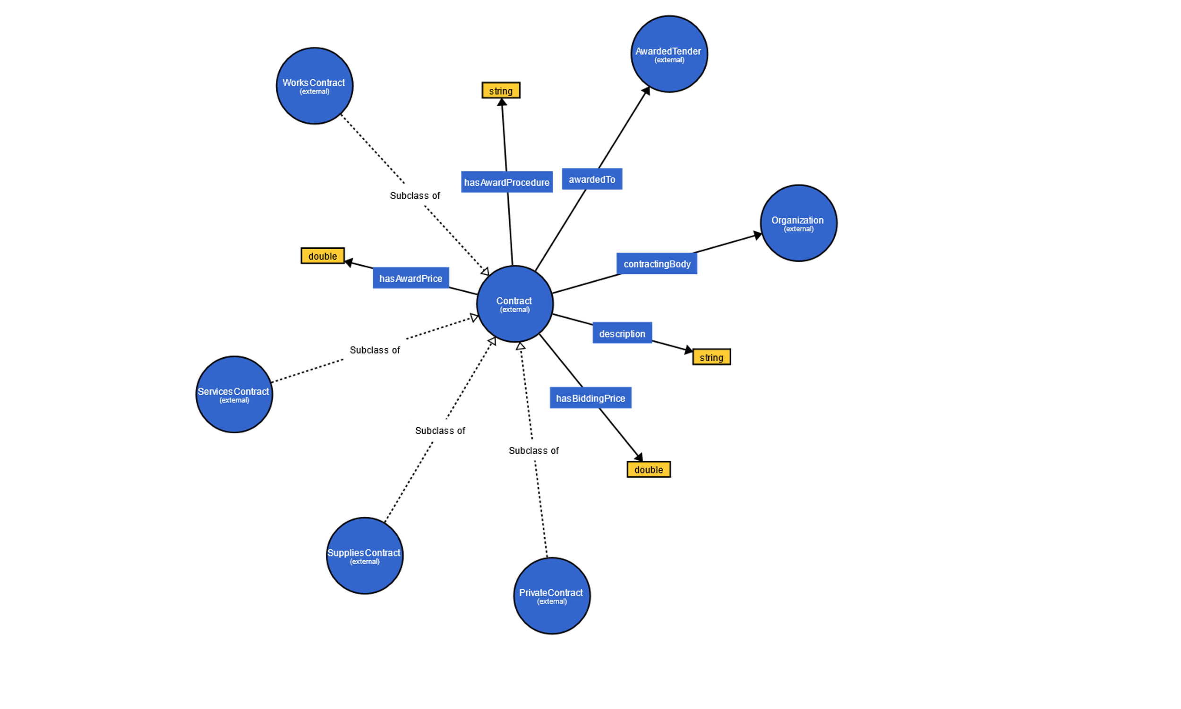
Define Naming Strategy
Base Uri: http://www.group01.org/aragon
Ontology: /ontology
Resources: /resource
Examples:
http://group01.org/aragon/ontology/hasAwardPrice
http://group01.org/aragon/resource/Company/RETEVISION_I_SA

Slide 6
Clean and Prepare
Remove some columns we are not insterested in, such as public instrument, year...
Remove rows with blank cells
Identify a unique key for every contract
Cluster similar values for companies and government requesters (Facets)
Convert prices to numbers in order to search for wrong or unusual values (Facets)

Slide 7
Link and Reuse
Ontologies reused were :
http://purl.org/dc/terms -> Description
http://contsem.unizar.es/def/sector-publico/pproc# -> Several classes and properties
http://www.w3.org/ns/org#Organization -> Goverment Requester
The entities that we were able to link with other datasets are the Companies and the Goverment Requester (Organization)
Wikidata
OpenCorporate

Slide 8
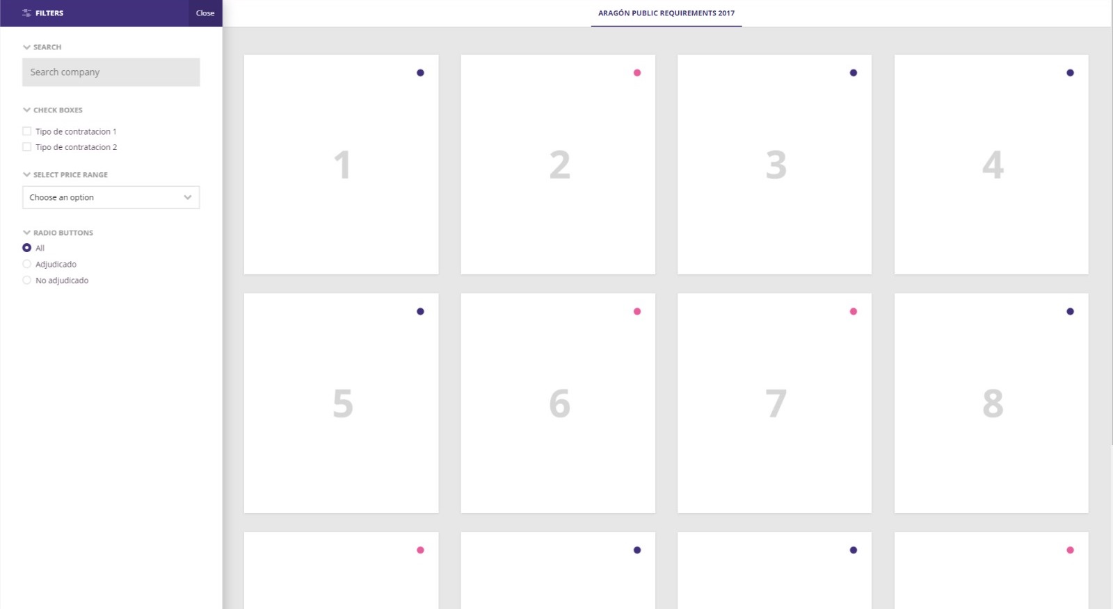
Develop Application: app requirements
Search engine to find all public procurements in Aragon on 2017.
Users can filter by each type of info.
Filter by dataset column
Display each row inside a card

Slide 9
II. Application
Publish data to be consumed at the level of SPARQL endpoint
Develop frontend
Develop back-end: query data & parse it to JSON
For each contract:
Load attributes
Query Goverment Requester
Query Company
App ready to view and filter data
1
2
2
3
4
1
RDF data (ttl format)
3
4
SPARQL endpoint

Slide 10
Demo

Slide 11
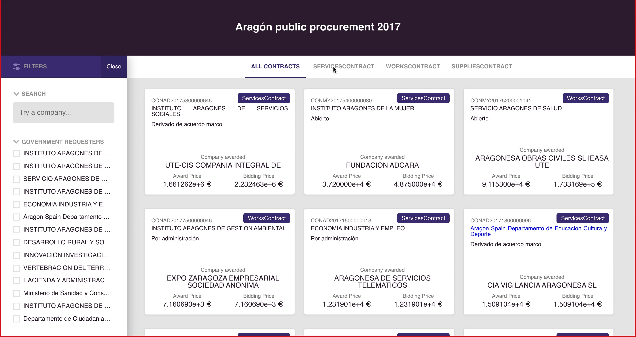

Slide 12
Q&A

